Slide 1
Spatial Influences on Health Information Technology Benefits in Rural Colorado
University of Colorado, Denver
Anschutz Campus
EHOH 6612, Final Project
Lynne VanArsdale / July 22, 2011

Slide 2
Agenda
Introduction and Background
Problem Statement
Previous Work
Methodology
Process map
Discussion
Planned Data Sources
Initial Project Plan
Expected Findings
Limitations

Slide 3
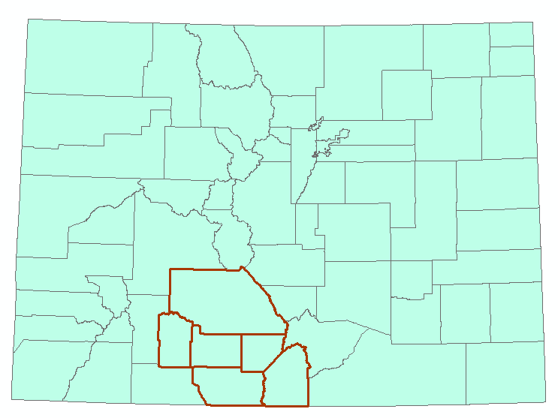
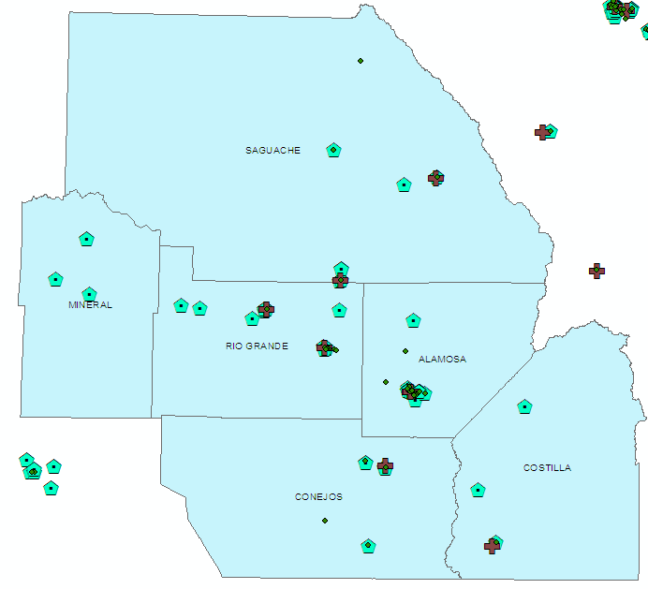
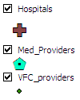
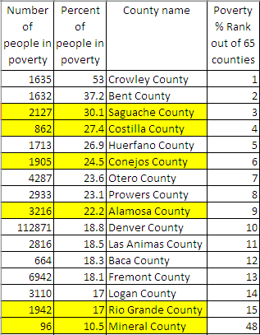
San Luis Valley
Dominant Social Characteristics:
Long established Spanish families
Highly innovative and collaborative

Slide 4
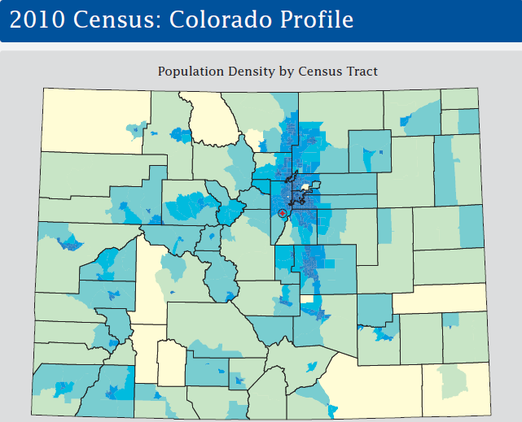
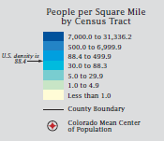
Sparsely Populated, Rural

Slide 5
Proposal to the Colorado Foundation
Colorado Foundation Target Outcomes:
  Healthy Living
    Increase the number of children and adults who engage in moderate or vigorous physical activity.
    Increase the number of children and adults who eat adequate amounts of fruits and vegetables daily.
    Increase the number of children who receive healthy meals at school and have access to healthy food and drinks in vending machines.
    Increase the number of underserved Coloradans who have convenient access to recreational exercise and fruits and vegetables.
    Increase the number of parents who are educated on child development, nutrition and preventive health care.
    Increase the number of Coloradans who are educated on chronic disease management.
  Health Coverage
    Increase the number of children and adults who have adequate health coverage.
    Increase enrollment of eligible Coloradans in Medicaid and the Child Health Plan Plus (CHP+).
  Health Care
    Increase the number of underserved Coloradans who receive integrated care.
    Increase the number of underserved Coloradans who regularly receive primary, mental and oral health care.
    Increase the number of health professionals who serve underserved Coloradans.
    Increase the number of patients who receive evidence-based care for chronic disease.
Strategies:
  Promote Healthy Communities
  Develop Healthy Schools
  Ensure Adequate and Affordable Coverage
  Optimize Enrollment for Public Health Insurance Programs
  Improve Health Care Delivery
  Accelerate the Adoption of Health Information Technology
  Build Health Care Professionals Workforce

Slide 6
Intro / Background
HIT elements being introduced
  EMR / standard order sets
    Valley Wide
    San Luis Valley Regional Medical Center
  CORHIO connection

Slide 7
HIT and Health Outcomes in Rural Colorado
How will spatial characteristics of rural Colorado affect the health outcomes targeted with HIT improvements (EMR, CORHIO) in the San Luis Valley?
  Integration of care (including navigators)
    Metrics: 24 methods outlined in paper by Strandberg-Larsen, M. and Krasnik, A.
  Receipt of evidence-based care for chronic disease
    Usage statistics on standard order sets from surveys of hospitals, clinics and primary care providers

Slide 8
HIT and Health Outcomes in Rural Colorado
Investigative covariates:
  Proximity / Access characteristics
    Patient distance to providers
    Provider internet access
  Health professional training, proficiency and adoption
    Numbers of users/roles
      Proficiency
      Adoption
    Breadth of functions used
  Community characteristics (patients)
    SES
    Education
    Race
    Age
    Disease / comorbidities

Slide 9
Literature Review
Spatially-related challenges with rural health and HIT
Metrics for integrated health care and EBM for chronic disease
Covariates

Slide 10
Methodology / Process Map
Center Line data with address data
Look at results county-by-county
Matching / validation databases
  San Luis Valley Public Health databases
  UC Denver Health Survey

Slide 11
Data sources and Potential Error
Colorado state data
Health Survey data
CORHIO data
Hospital and clinic data
AHEC data

Slide 12
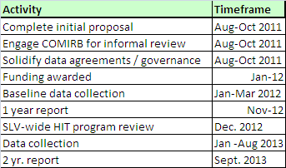
Timeline / Planned Schedule

Slide 13
Expected findings and contribution
Improvements in the target outcomes
  More prevalent closer to the hospitals
  Higher rates of using EBM for chronic patients
  Better integration of care
Look at covariates for control
  Identify confounders and effect modifiers
  Recommend programs that uses those covariate parameters to enhance outcomes

Slide 14
Limitations
One year timeframe
Data availability (permissions)
Data accuracy

