Slide 1
Project Management for
Bioentrepreneurs
May 9, 2012
Lynne VanArsdale, lynne.vanarsdale@ucdenver.edu

Slide 2
Class Agenda
Activities
Objectives
What is project management?
Why care about it?
Presentation of two cases
Project management best practice – Agile and Waterfall
Scope, dependencies, resources and schedules
Last words
Work on cases
Understand how project management helps entrepreneurs
Understand basic project management approaches that prove most useful
Apply techniques to risk and priorities decision-making and operations

Slide 3
Pro(du/je)ct Management
Driven by Users
Planning
Just Execute

Slide 4
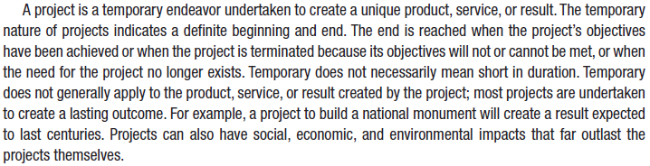
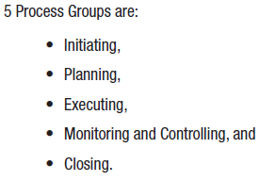
What is Project Management
Managing the project involves:
Identifying requirements
Stakeholders
Balancing constraints
  Scope
  Schedule
  Quality
  Budget
  Resources
  Risk

Slide 5
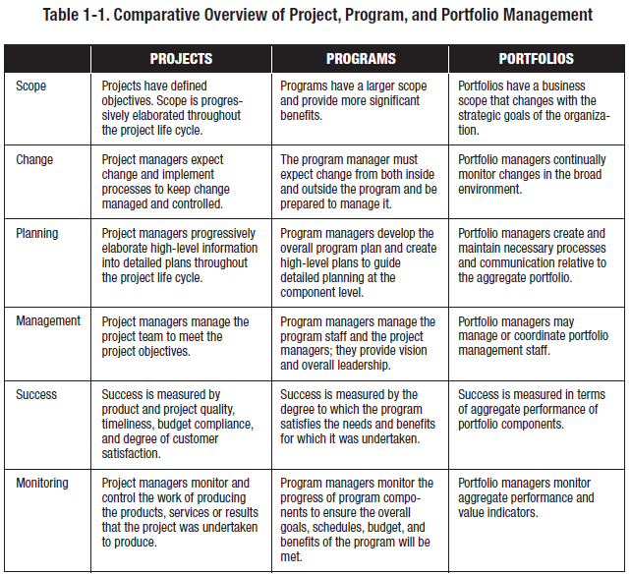

Slide 6
Why Is Project Management Important to Bioentrepreneurs?
Risk management
  Dependencies and interfaces
  Impact and likelihood
  Root cause
Communication
  Market / Clients
  Partners
Cost
Trust

Slide 7
The Project Charter
Create a project charter for each project!!!
Title
Purpose
Stakeholders
Scope
Requirements (high level)
Resources / Team
Pro forma schedule
Previous similar work
Interfaces with other projects
Communication plan
Budget
Constraints
Risks
Approval!!!

Slide 8
Case #1: Risk
Dr. Arthur Ambrose, a primary care doctor in private practice with affiliations at all the large hospitals in his area, plans to bring a new glucose monitor to market. This monitor plugs into a smart phone and sends the measurements to an application that runs in a secure cloud. This application tracks each patient’s glucose levels and allows the patient to enter his/her own information on treatments and behaviors that affect the management of their disease. His development team is a talented team of software engineers from China. He was able to write a detailed specification for the device and they accurately built what was specified, in Arthur’s estimation. He was pleased. He found a group of people with Type 1 diabetes and asked them to use the device. They loved it! Arthur had never filed for certification and approval of medical devices before, but knew it was necessary and was about to start down that road.
Questions:
What projects, face Arthur right now? How would you define scope and requirements? Who are the stakeholders?
What is the best next step for Arthur with regard to the impending project(s)?
How important is risk management to each project? What are the risks? What are the impact and likelihood of each risk?
What is the best method of project management for each project and why?
How would Arthur best estimate time to market for his product?

Slide 9
Case #2: Stakeholders
Jinny Chen created an LLC to manufacture medical device prototypes for inventors. She also provides a service that helps the inventors through the regulatory approval process. Her delivery team consists of a number of partners. Some of the partners are sole proprietors and some are small companies. An handful of her partners are local to her community, but the majority are overseas in India and China. Recently a grant opportunity was announced by the federal government to encourage entrepreneurship. Jinny’s business tripled overnight. She was pushing out orders faster than ever. Her partners were calling every five minutes with questions and correction requests for the orders. One of her partners, after an afternoon of calls, told her that they could not accept any more orders from her for two weeks due to their backlog.
Question:
What projects does Jinny need to undertake? What are all of the charter elements for these projects? What methodology should she use for each project?
From the stakeholder analysis, who is the most important stakeholder to satisfy in the short term and in the long term? Why? How would she address the needs of each?
How would you construct a risk analysis for Jinny based on her stakeholders’ needs? How might the risk analysis aid in prioritization of projects and activities?
What dependencies will Jinny likely encounter in her project planning? How should she manage those dependencies?

Slide 10
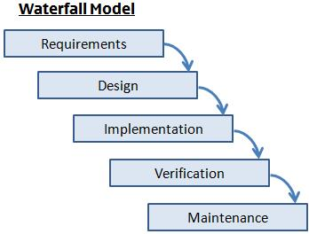
Project Management Best Practice – Waterfall
Well-defined
Well-known
Low risk
Throw it over the wall
Complex interfaces
Can be combined with Agile

Slide 11
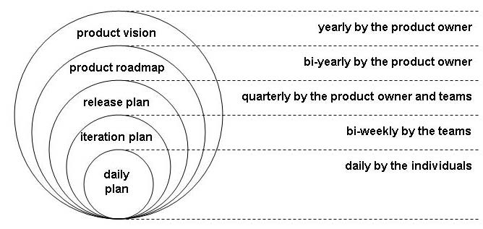
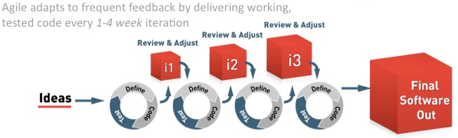
Project Management - Agile

Slide 12
Scope, dependencies, resources and schedules
1. Stakeholder analysis
Name | Org | Role | Influence | Priority | Relationship | Contact
Short identifier | Small and large granualarity | What role to they play in the project and in the project context | H/M/L with description of how they influence project outcomes and operations | Ranking or H/M/L | Dependencies, authority, concerns and responsibilities | Key contact people – may be a database

Slide 13
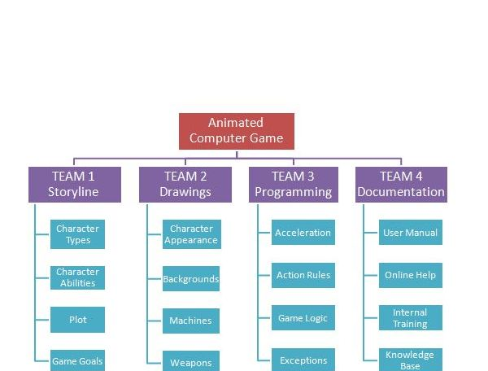
Scope, dependencies, resources and schedules
2. Work Breakdown Structure
www.brighthub.com

Slide 14
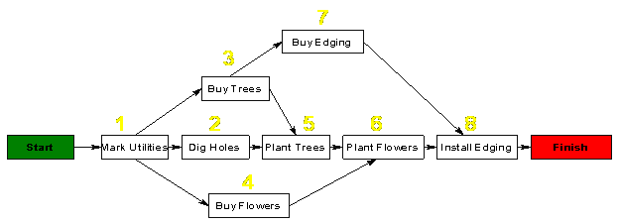
Scope, dependencies, resources and schedules
3. Activity Diagram
http://krypton.mnsu.edu/~tony/courses/609/PERT/tech.html

Slide 15
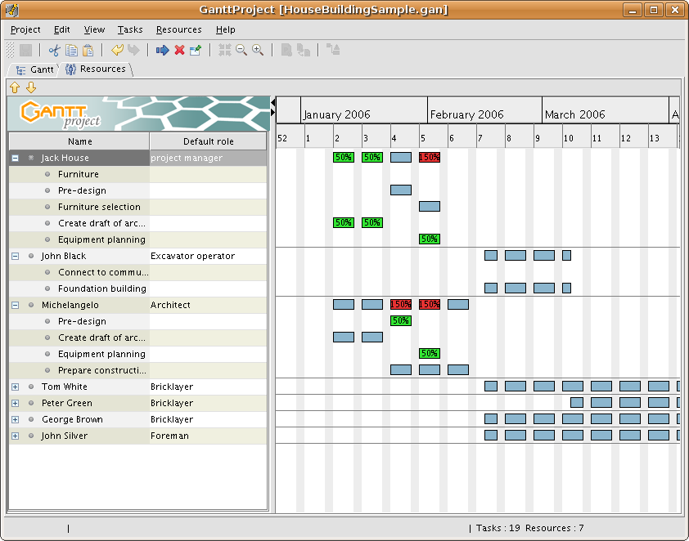
Scope, dependencies, resources and schedules
4. Resource Planning
www.kayoprojectmanagement.com

Slide 16
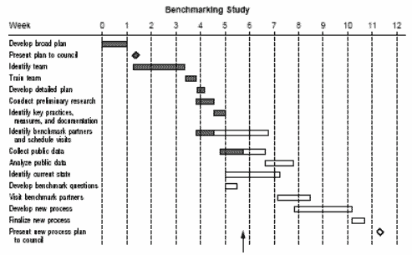
Scope, dependencies, resources and schedules
5. Gantt Chart
http://health.state.mn.us

Slide 17
Most Important
DOCUMENT!
Plan!
History / Lessons Learned
Process
Computer-readable / digestable

Slide 18
Summary
More information: www.pdma.org, www.aipmm.org
Questions?
lynnevanarsdale@msn.com

