Slide 1
Product Management for
Bioentrepreneurs
April 25, 2012
Lynne VanArsdale, lynne.vanarsdale@ucdenver.edu

Slide 2
Class Agenda
Activities
Objectives
What is product management? (5 min)
Why care about it? (10 min)
Product management best practice (30 min)
Product management risks, pitfalls and opportunities for entrepreneurs (30 min)
Break (15 min)
Three cases (25 min. each)
Summary, review, questions (15 min)
Understand how product management can improve business outcomes and resilience
Understand the basics of how to manage products and product portfolios
Discover risk management approaches for innovation projects through effective product management

Slide 3
What is Product Management
Definition – art + science and the importance of intuition
Product Management and Marketing
Other related disciplines
What to expect from product management

Slide 4
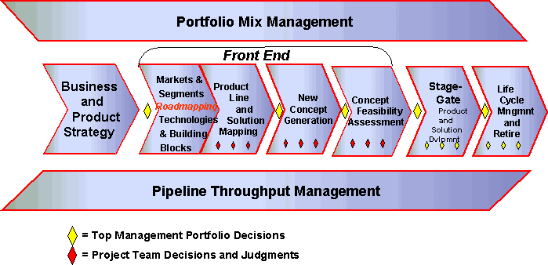
Product Management Lifecycle
Source: Kahn, Kenneth B., Editor, The PDMA Handbook of New Product Development

Slide 5
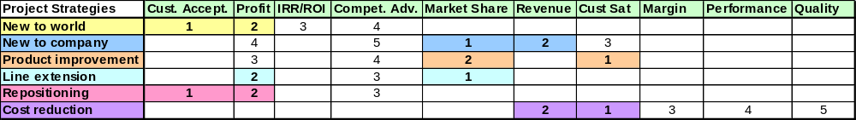
Business Strategies and Project Types
Business Type or Firm Strategy
Description
Goal Orientation or Measure of Success
Prospector
Growth through new products
First to market
Profits, sales from new products
New market opportunities
Analyzer
Rapid deployment of well conceived products
Fast Follower
Effectiveness
Efficiency
Low High
Level of Innovation
Defender
Maintain a secure position in a stable market
Quality
Cost
Reactor
Responds when forced to do so
Passive
Efficiency
Financial performance
Notes:
Prospector:
Innovators
First with new products even at short term loss
First to adopt new technologies
Respond rapidly to new opportunities
Analyzers:
Fast followers
Bring superior or more cost effective products to market
Monitor competitor entries
Defender:
Maintain a secure position in a stable market
Protect position through higher quality, superior service or lower price
Reactor:
Respond only when forced by strong external or market pressures
Not as aggressive in maintaining established products and markets as competition

Slide 6
Roadmaps, Markets and Segments
Charter: Research and Initial Engagement
Who are the real customers?
Where have they been and where are they going?
  Why can you win?
  Market opportunity
  Factual customer information
  Defined customer needs
  Relative competitive position
  Customer value
  Match with your core strengths and strategy
Key Activities
Market and competitive research
Initial market participant relationships
Reports and consensus
Product and portfolio directions/strategy refinement
Product line and solution mapping

Slide 7
New Concept Generation
Problem-based Ideation
Concept Generation → Concept Statement
  Gathering the problems
  Problem analysis or problem-based ideation
  Scenario analysis
  Solving the problems
Metric: Utility = how much a feature contributes to buyer interest/preference
Hardest part: finding a problem that the customer is willing to pay to have it solved
Ideation:
Affinity charting
Delphi Process
Nominal Group Process
Divergent thinking
Convergent thinking
Problem-based
Notes:
Concept Generation → Concept Statement
Gathering the problems
Marketing and sales data direct from customer/prospects
Input from technology and other marketing staff
Problem analysis or problem-based ideation
Step 1: Determine the product or activity category →Product Innovation Charter.
Step 2: Identify target market members
Step 3: Gather the info from users on what they want & are getting
Step 4: Sort and rank the problems
Methodologies to use
Experts – as surrogates for end users
Published Sources – industry studies, gov’t reports, university research
Stakeholder Contacts – ask them directly
Interviewing – one-on-one is most common
Focus Groups – yield exploratory discussion to uncover genuine problems
Observation – watching customers (or noncustomers) in their own environment
Role playing – when users are unable to visualize or verbalize their actions
Product function analysis – verb + noun → “mini-concepts”
Scenario analysis
Predicting the future
Paint the scenario
Study for problems and needs
Evaluate and solve
Solving the problems
Group Creativity – two heads are better than one
Brainstorming
Deferral of judgement
Quantity breeds quality
Electronic brainstorming or Computer-Assisted Creativity Techniques to log ideas anonymously
Disciplines Panel – assembly of cross-functional experts to discuss the problem
Metric: Utility = how much a feature contributes to buyer interest/preference

Slide 8
Concept Feasibility Assessment
What has been done?
What could be done?
What have we done?
What could we do?
What are we best at doing?
How would we produce this product?

Slide 9
Formulae for Success
Focus on value (relationship with market)
Increase knowledge (learning)
Build-in agility (anti-arrogance/power)
  A note on Agile…
Structure-in resilience (elasticity)

Slide 10
Break
Please be back at 9:30 am

Slide 11
Case Studies
Form a work group of no more than 12 people
Designate a recorder and a reporter
Read the case together and discuss questions (15 min)
  Recorder takes notes
Report your conclusions to the group

Slide 12
Case #1: Public Health Community Engagement
Situation
Questions
The county Dept. of Public Health has a mandate from the state to use its recently completed health assessment to make an improvement in county health over the next 3-5 years.
A group of county citizens was assembled to decide on what would be the target for improvement and how the target would be reached.
After a series of meetings where Public Health presented county-level data on health conditions, the group was surveyed to determine which condition they wanted to address and what resources they would bring to the improvement effort. They decided to work on reducing obesity and increasing fitness for county residents
The group now needs to work on the next step.
Who is the real customer? What does the real customer value?
What is the high level charter for the next step project?
As a project manager for the next step, what information would you need to map out a project plan?

Slide 13
Case #2: Wellness Game
Situation
Questions
You and some friends want to help one another improve their health, and have come up with a game idea. You create a game that collects results from each person’s home exercise machines, shares them with one another in real time over the internet and allows you to compete for the monthly “Ruler of Fitness” designation within the group.
After three months of great fun with this game, you all decide that it would make a great product to bring to market. You’re aware of the game innovation program at UCCS and you think it would be great to engage a bunch of college students to help you create a wellness game to sell on the internet.
Who are the real customers?
What is the first project you should undertake?
What is the high level charter for this project?
How might you plan the project to properly manage risk for your key stakeholders?

Slide 14
Summary
Innovation work can be accomplished better with project management
Best practice in product management provides a framework for product lifecycle projects (especially launch!)
Focus on value, knowledge, agility and resilience in product projects
More information: www.pdma.org, www.aipmm.org
Questions?
lynnevanarsdale@msn.com

